Slide 1
CZ2001 Project 1
Searching Algorithm
SS4 Group 2:
Selvira
Glenda
Jia Tian
Ernest Wee Li

Slide 2
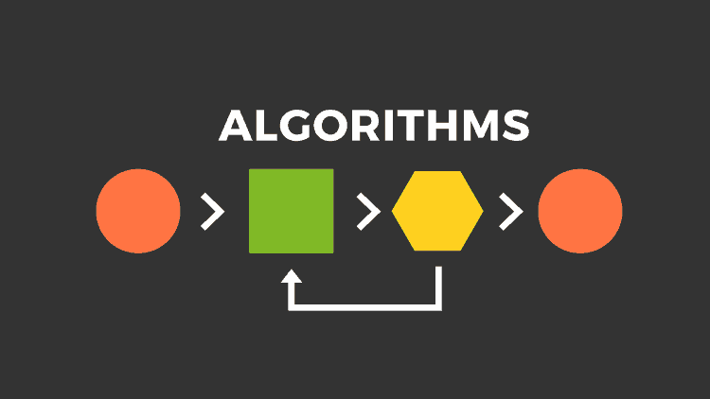
Table of Contents
Brute Force
2. Algorithm 1
3. Algorithm 2
4. Demo

Slide 3
Brute Force
Using raw computing power over efficiency
Simple to implement
Guaranteed to find solution if it exists, given enough time
Time taken to find solution increases exponentially with larger data
Inefficient. May iterate through same data multiple times
Notes:
Baseline algorithm
Basic sequential search
Algorithm iterates through entire DNA sequence and check every index for match to first index of query sequence
If match → while loop to check rest of query index
Once mismatch, return to iterating through dna sequence

Slide 4
Time Complexity (Brute Force)
Best Case : O(n)
DNA = “CTGAGTCT”
Query = “AGT”
Query sequence appears only once in DNA sequence & first character of query also appears only once.
* n refers to length of DNA sequence
m refers to length of query sequence
Notes:
The query sequence only appears once in the DNA sequence and the first character of the query also only appears once.
Algorithm will only go into the while loop to match DNA with query once.

Slide 5
Time Complexity (Brute Force)
Worst Case : O(nm)
DNA = “AAAAAAAAAT”
Query = “AAT”
DNA sequence matches with query at every index except for the last query nucleotide.
Enter while loop n times
Time taken for each loop : O(m)
* n refers to length of DNA sequence
m refers to length of query sequence
Notes:
First index match at each nucleotide in DNA sequence.
Algorithm will enter while loop at every index of the DNA sequence and iterate until the last query nucleotide.

Slide 6
Space Complexity (Brute Force)
Algorithm uses constant space of 2 integer variables
Hence : O(1)

Slide 7
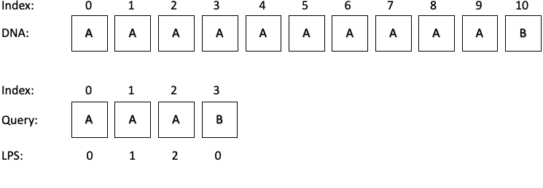
Algorithm 1

Slide 8
Algorithm 1
Similar to that of brute force algorithms but with better worse-case performance. Store previously matched data and determines the next furthest position in the data to continue iteration.
Worst-case performance is better than normal brute force algorithms
Time linear algorithm, suitable for searching in large datasets
Extra space required to store previous matching information
Notes:
Based on KMP string search algo
Creates a table that stores info of previous searches
Allows algorithm to identify and skip past indexes that does not match query

Slide 9
Time Complexity (Algorithm 1)
Best Case / Worst Case : O(n+m)
create_lps_table() :
Algorithm will iterate through the loop m times, O(m)
kmp_search()
Algorithm does not backtrack to any previous index of DNA sequence
Maximum false comparisons == 1 , at every index
Maximum comparisons == 2n ,thus O(n) time
O(n) + O(m) = O(m+n)
* n refers to length of DNA sequence
m refers to length of query sequence

Slide 10
Space Complexity (Algorithm 1)
Space required for LPS Table: m + 4
→ Size of query m + 4 temp variables to store the nucleotides (A T C G)
which will help us construct the LPS Table
Hence : O(m)

Slide 11
Algorithm 2
Searching algorithm that uses hashing. A hash function was created specifically for DNA matching that can compute hash values with 0% false positive rate. Each unique sequence will have its unique hash value, thus there is no need to do index-by-index checking.
Hash values can be computed and compared quickly
Does not require additional loop to verify matches
Requires additional space to compute and store hash values
Cannot accept large input sizes
Notes:
Based on Rabin Karp algorithm, but with improvements and specific modifications to match our problem
Since data of DNA/RNA can be represented fully with only have 5 different letters ( A C G T U)
We created a specific hash function that maps each different nucleotide to a specific digit number.
Thus, every unique sequence will have a unique hash value
Therefore no need to do index by index checking if hash values match.

Slide 12
Time Complexity (Algorithm 2)
Best Case / Worst Case : O(n+m)
create_hash():
Algorithm iterates through the query and DNA sequence, O(n+m)
rk_search():
Algorithm iterates through entire DNA sequence only once, O(n)
If hash values of DNA sequence and query sequence match, position is returned (no index-by-index checking required)
O(n+m) + O(n) = O(n+m)
* n refers to length of DNA sequence
m refers to length of query sequence

Slide 13
Space Complexity (Algorithm 2)
At each iteration, the hash value of DNA sequence is calculated and compared to hash value of query sequence
Once completed, hash value is updated for the next iteration
Constant space usage independent of input size
Hence : O(1)
Notes:
There is only 1 hash value of the current DNA sequence to be compared to the query’s hash,
And this same hash value gets updated throughout the sequence.
There is constant space use, independent of input size.
Thus space complexity is O(1).

Slide 14
Demo

Slide 15
Thank You!

